Slide 1
Simplifying fractions
Comparing and ordering fractions and decimals (positive and negative)

Slide 2
how to use Oak lessons

Slide 3
I can simplify fractions by dividing both the numerator and denominator by common factors and know why this works.

Slide 4
A factor is a term which exactly divides another term.
The highest common factor is the common factor which can be divided by all other possible common factors.
Expressing a number as a product of primes means writing it uniquely as a product of its factors that are prime numbers.

Slide 5

Simplifying fractions
Simplifying fractions using factor pairs
Simplifying fractions using prime factors

Slide 6



Simplifying fractions using factor pairs
When you multiply two positive integers your answer will always get bigger.
Oh Izzy, you are right. I forgot about multiplying by one.
Yes, if you multiply anything by one the answer remains the same.
I don’t think that is true.
Alex
Izzy

Slide 7

Simplifying fractions using factor pairs
Can you think of any other ways of writing the number one?
It can. Any fraction with the same numerator and denominator is one.
Yes,
and an infinite number of others.
One can be written in lots of different ways.
Alex
Izzy

Slide 8
Simplifying fractions using factor pairs
Whose method do you prefer?
I preferred Alex’s method.
Why do you think I prefer that method?
I preferred Alex’s method, because it is more efficient.
Alex
Izzy

Slide 9
Simplifying fractions using factor pairs
What is special about Alex’s method?
What makes it more efficient?
I can see why. It’s because you chose your first factor pair to include the highest common factor.
True, but I am going to try and use your method from now on because it is more efficient.
It doesn’t matter though because you got the right answer anyway.
I managed to do it in one step, you took two. Why was that?
Alex
Izzy

Slide 10
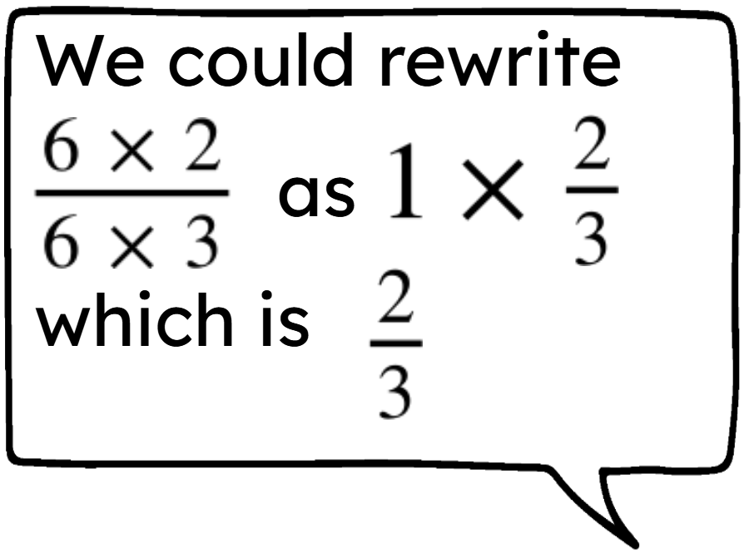
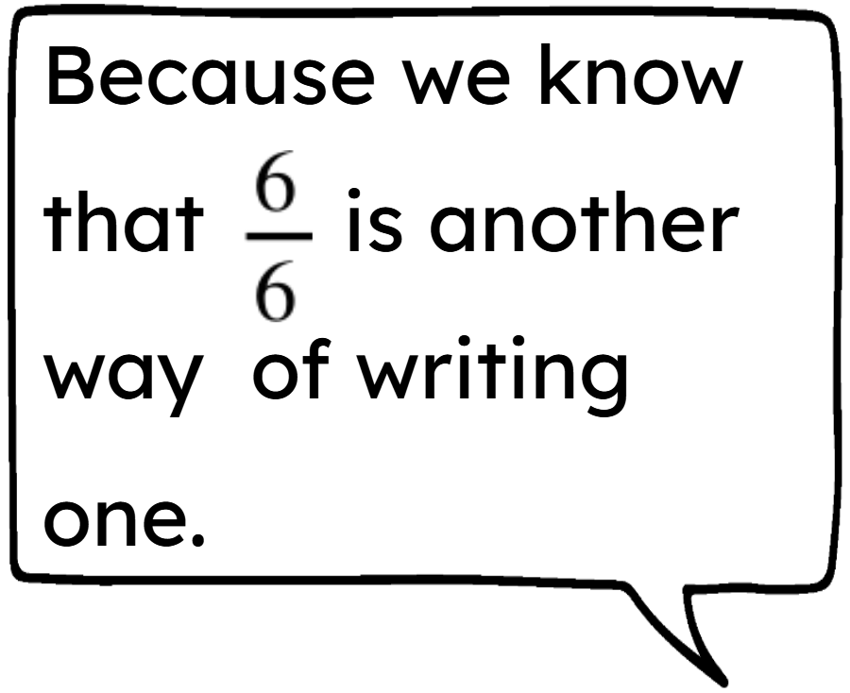
Simplifying fractions using factor pairs
Why does
?
Yes, and anything multiplied by one stays the same.
Why can we just get rid of the sixes?
Alex
Izzy

Slide 11
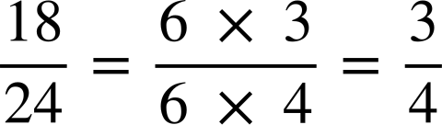
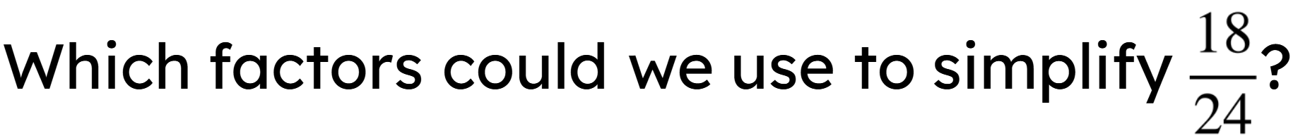
Simplifying fractions using factor pairs
The HCF of two integers is the greatest number which is a factor of both integers.
Simplify
Factors of 18
Factors of 24
1 × 18
2 × 9
3 × 6
1 × 24
2 × 12
3 × 8
4 × 6
Which would be the most efficient?
6 because it is the HCF.

Slide 12
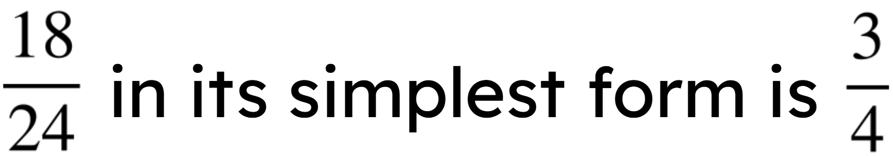
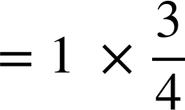
Simplifying fractions using factor pairs
Simplify
HCF of 18 and 24 is 6.
equivalent to 1

Slide 13
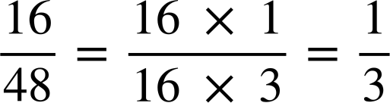
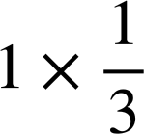
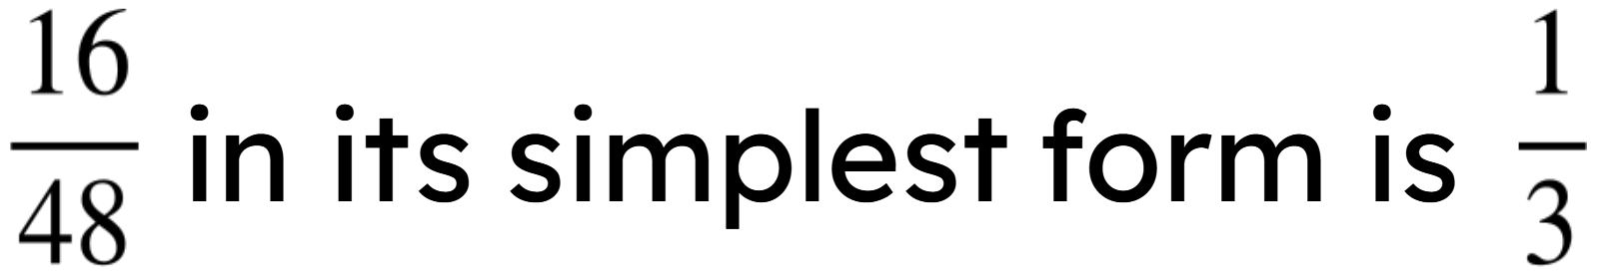
Simplifying fractions using factor pairs
Simplify
HCF of 16 and 48 is 16.
equivalent to 1
Factors of 16
Factors of 48
1 × 16
2 × 8
4 × 4
1 × 48
2 × 24
3 × 16
4 × 12
6 × 8

Slide 14


Simplifying fractions using factor pairs
4 is a common factor but not the HCF, you will get the right answer but it is not the most efficient method.
4
8
8 is the HCF of 40 and 56.
14 is a factor of 56 but it is not a factor of 40. The factor you choose must be common to both the numerator and denominator.
14

Slide 15

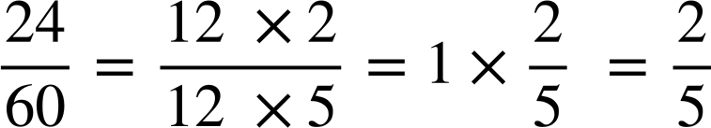
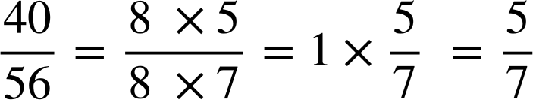
Simplifying fractions using factor pairs
Simplify
Simplify
Would it matter if we left out this step?

Slide 16
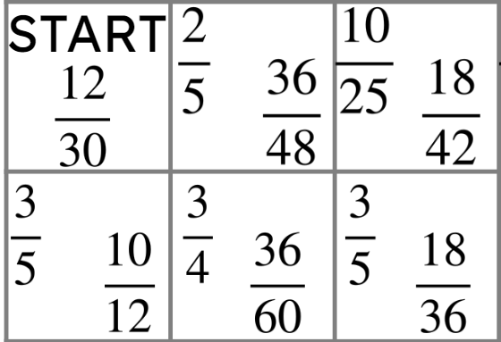
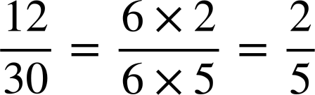

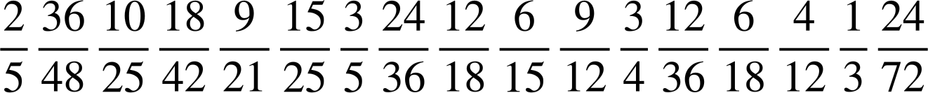
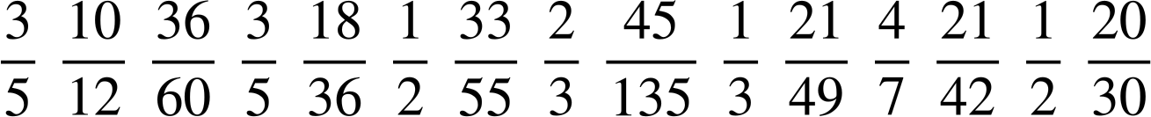
Simplifying fractions using factor pairs
Here is a section of a maze where you find the path by simplifying fractions.
Starting with the START square.
Does
simplify to
or
?
This means we go to this space next.
Then we simplify the fraction in the bottom right of this space to see where to go next.

Slide 17
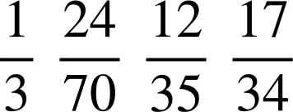

Simplifying fractions using factor pairs
Find your way through the maze by simplifying the fractions.
What simplified fraction should go in the end box?
START
END

Slide 18














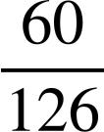

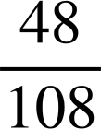



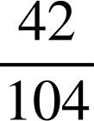
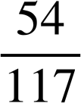



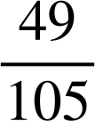


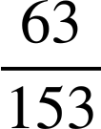
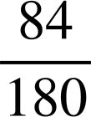
Simplifying fractions using factor pairs
2) Which fraction in each row does not simplify to the fraction in the first column?
a)
b)
c)
d)
e)

Slide 19
Simplifying fractions using factor pairs
Find your way through the maze by simplifying the fractions.
What simplified fraction should go in the end box?
START
END

Slide 20
Simplifying fractions using factor pairs
2) Which fraction in each row does not simplify to the fraction in the first column?
a)
b)
c)
d)
e)

Slide 21
Simplifying fractions
Simplifying fractions using factor pairs
Simplifying fractions using prime factors

Slide 22
Simplifying fractions using prime factors
Oh, yes you’re right. That will be really useful if we need to simplify fractions with larger numerators and denominators.
I have just realised. We can find the HCF of two integers using the product of prime factors.
Alex
Izzy

Slide 23
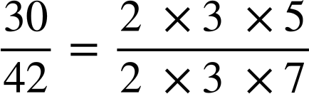
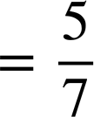
Simplifying fractions using prime factors
Simplify
equivalent to 1

Slide 24
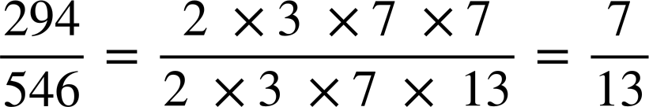
Simplifying fractions using prime factors
Simplify

Slide 25
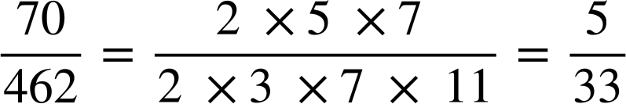
Simplifying fractions using prime factors
Simplify

Slide 26
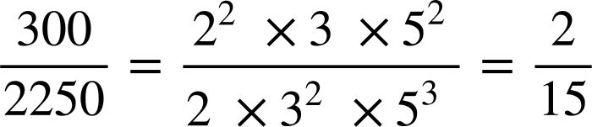
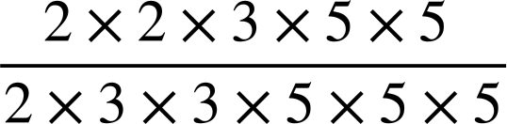
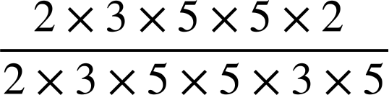

Simplifying fractions using prime factors
Take out of exponent form
Simplify
Move all of the common factors to the front

Slide 27
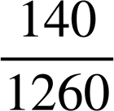
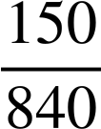
Simplifying fractions using prime factors
Simplify
Simplify

Slide 28
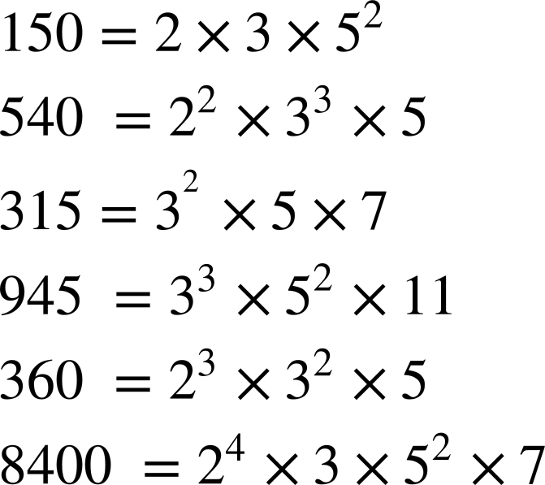
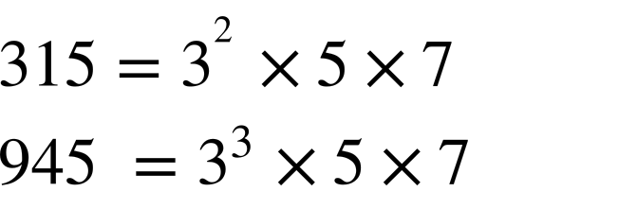
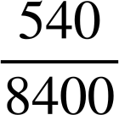
Simplifying fractions using prime factors
Use these prime factorisations to simplify the fractions.
a)
e)
b)
f)
c)
g)
d)
h)

Slide 29
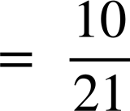
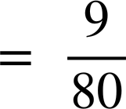
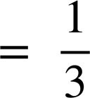
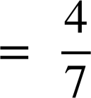
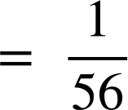
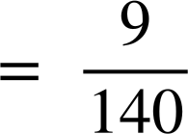
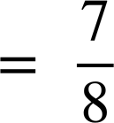
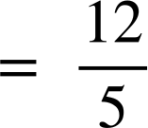
Simplifying fractions using prime factors
Use these prime factorisations to simplify the fractions:
a)
e)
b)
f)
c)
g)
d)
h)

Slide 30
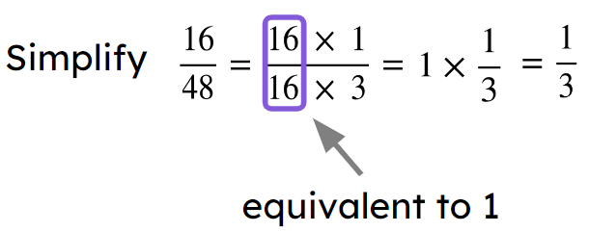
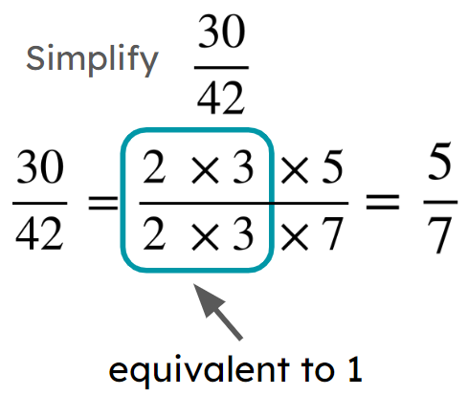
Simplifying fractions
Fractions can be simplified using factor pairs.
The most efficient way to do this is using the HCF.
E.g.
Products of prime factors can also be used to simplify a fraction. E.g.

Slide 31

© Oak National Academy 2023.
Produced in partnership with Mathematics in Education and Industry.
Licensed on the Open Government Licence v3.0, except where otherwise stated. See Oak terms and conditions.

